Slide 1


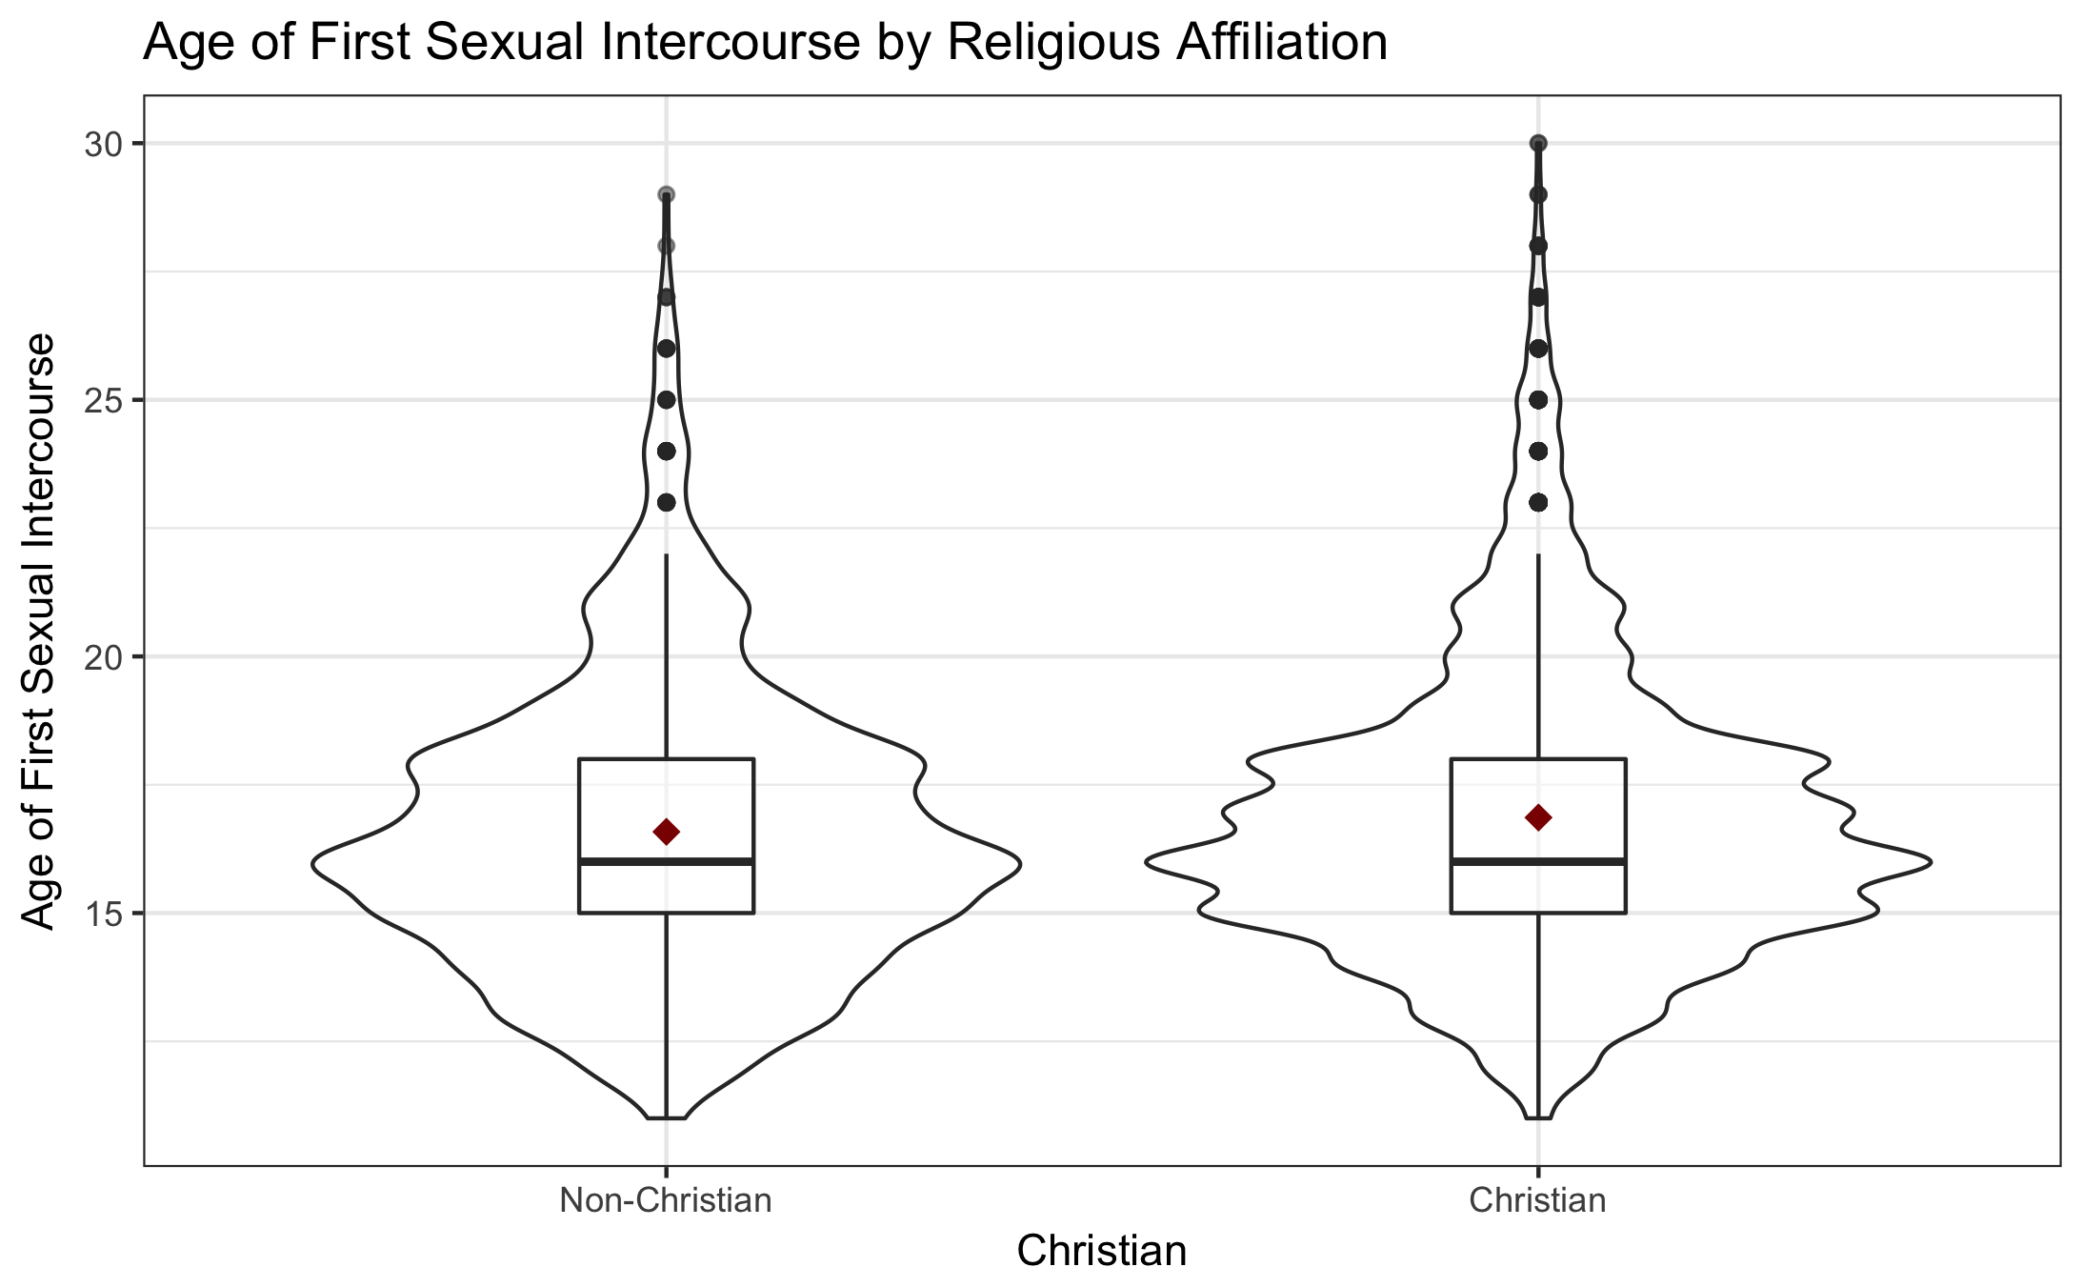
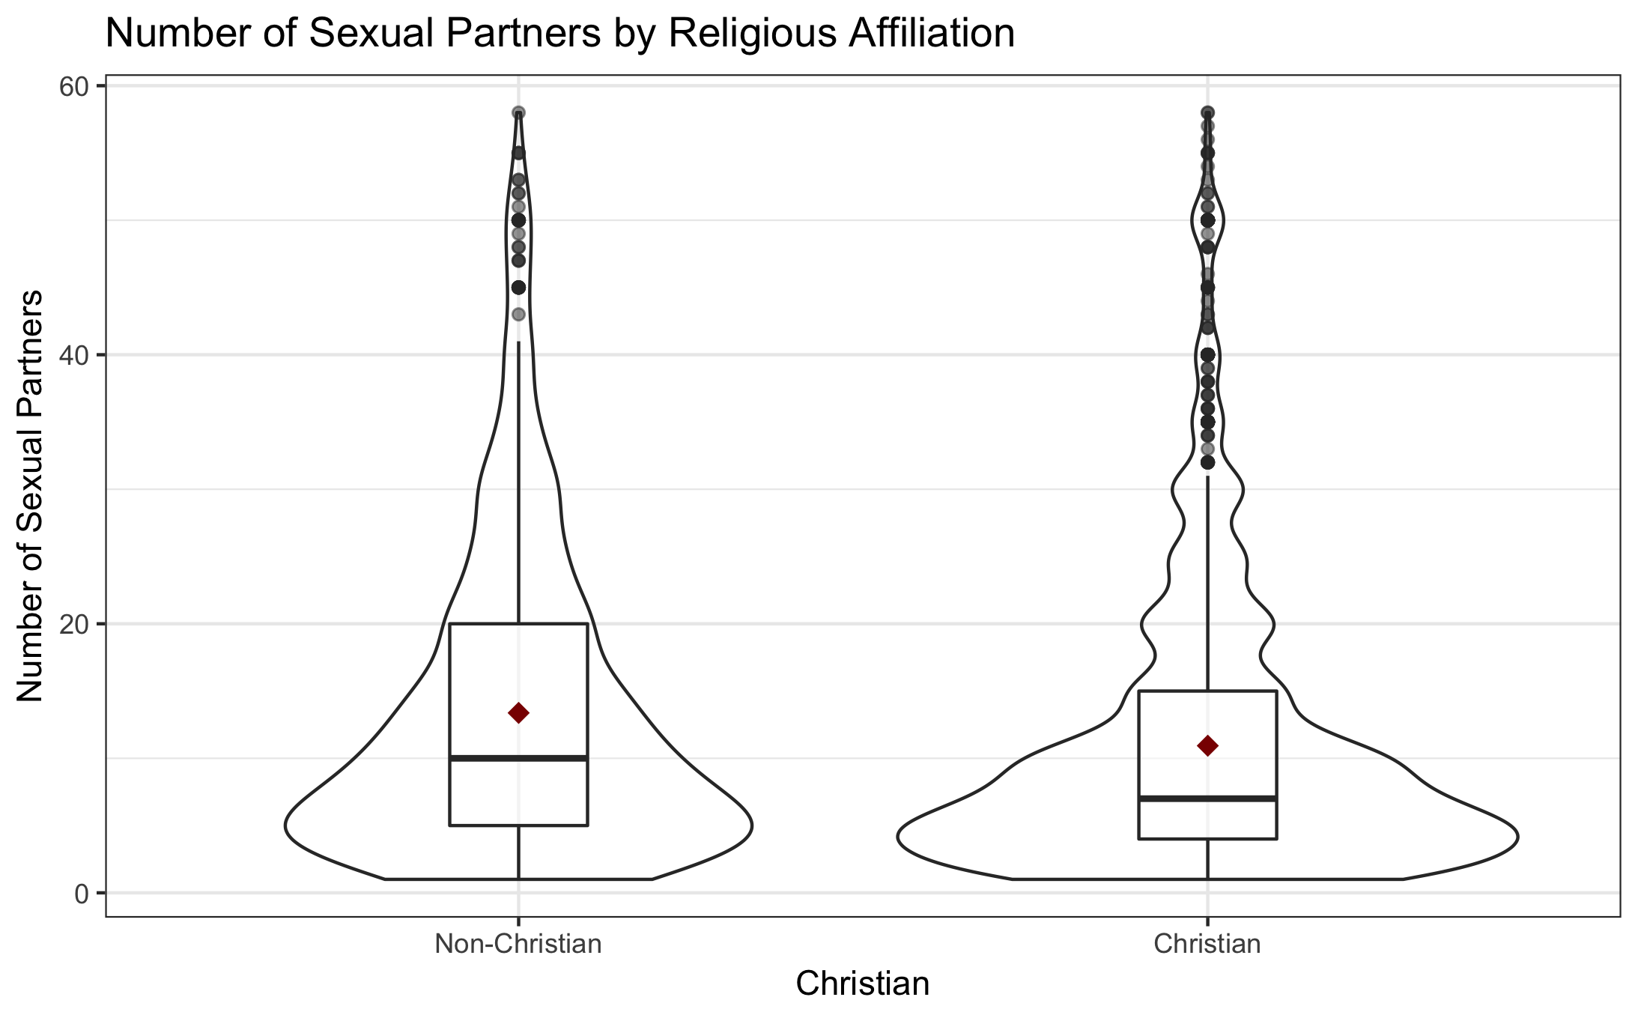
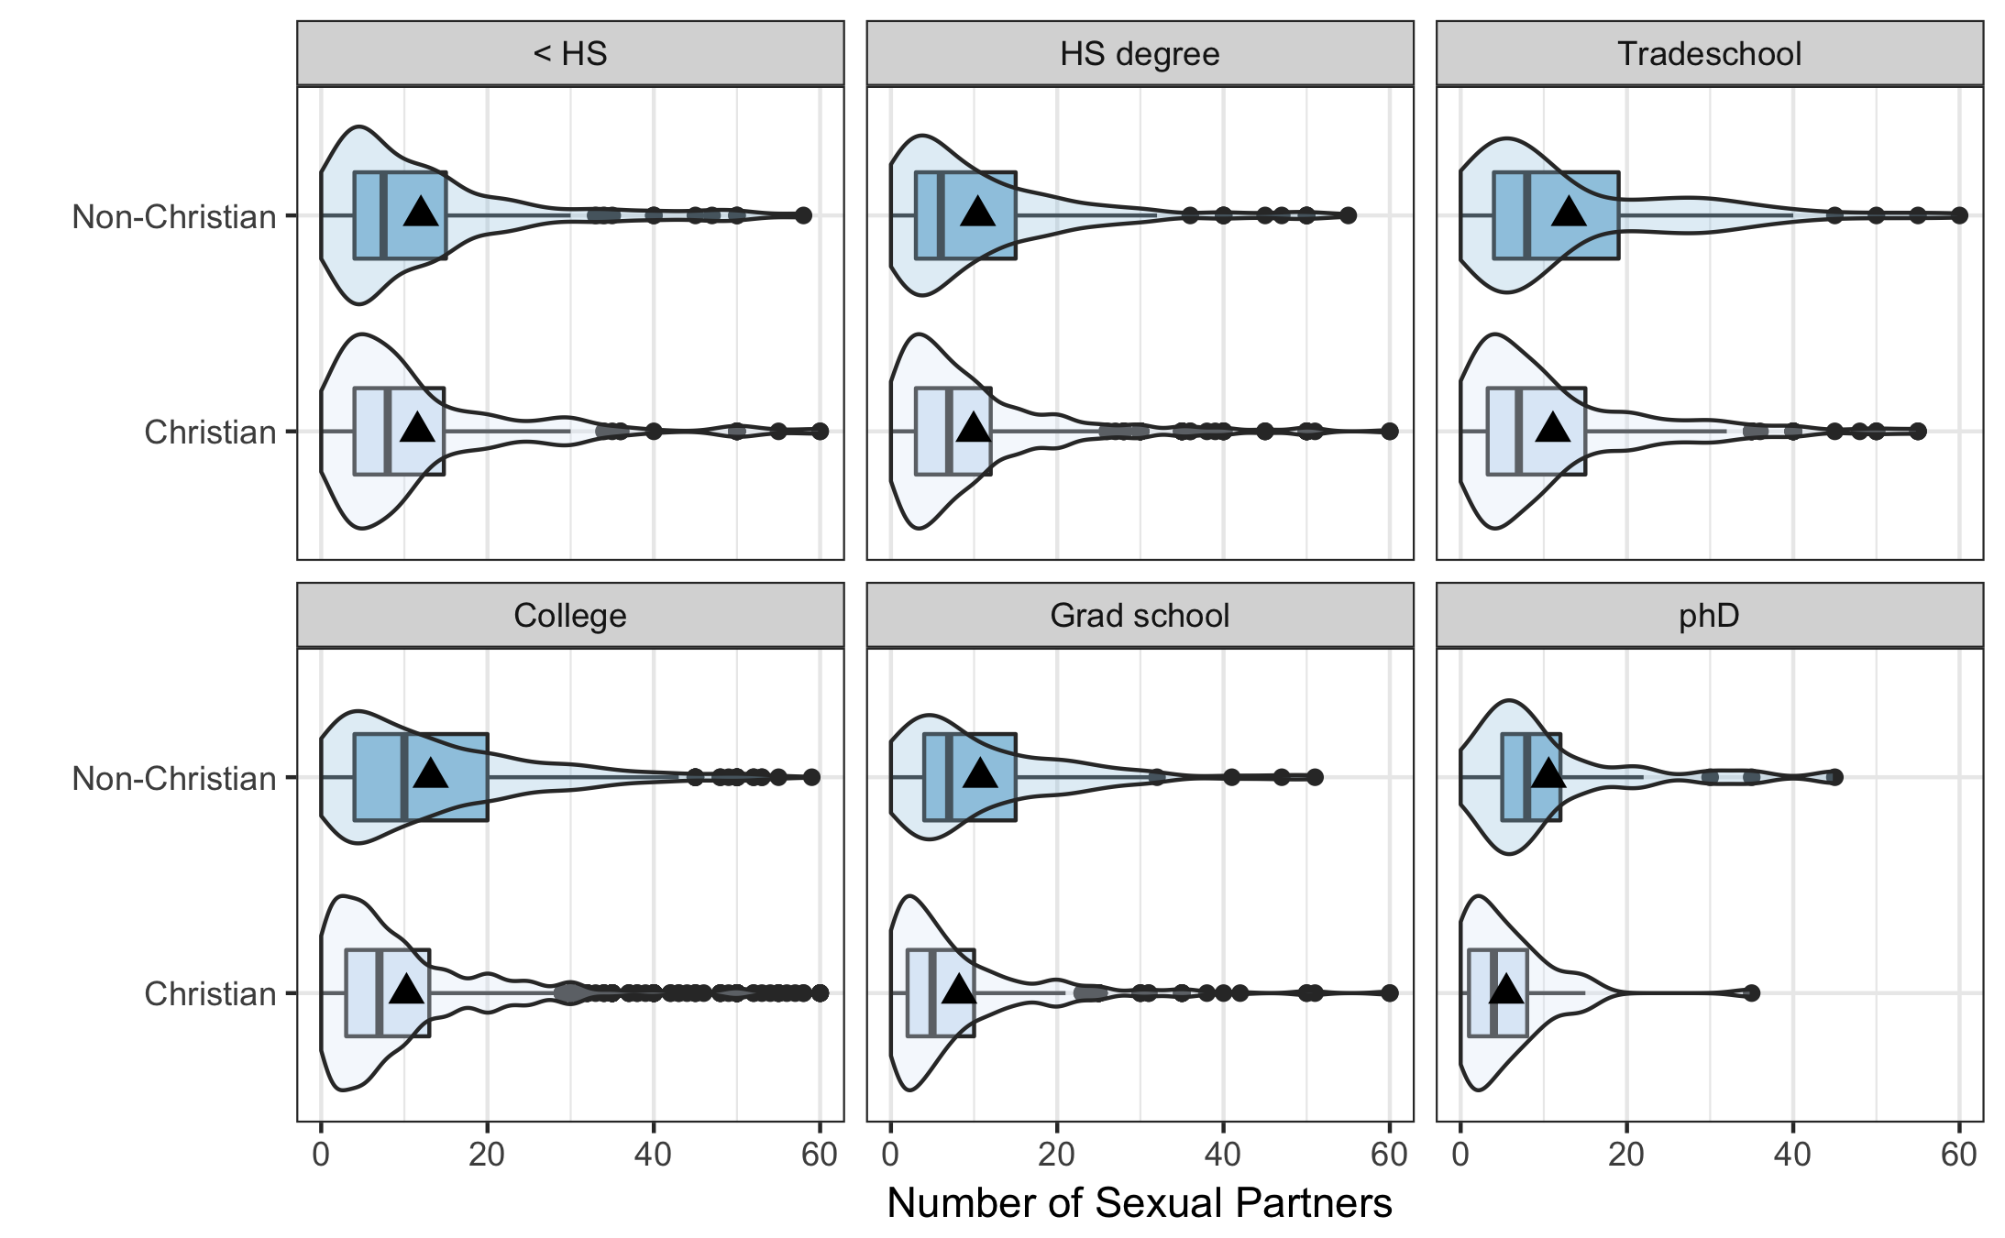
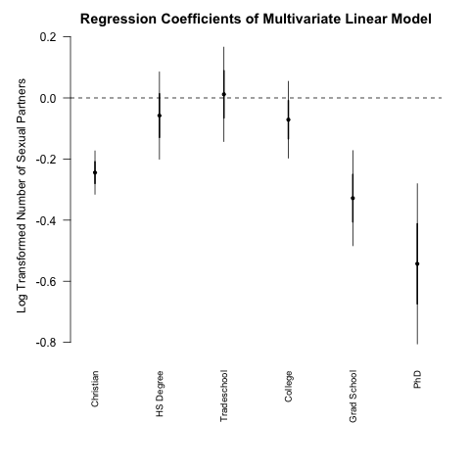
The Relationship Between Religious Preference and Sexual Promiscuity
Stompe, Dylan K.
Math 615, Fall 2017
Introduction
Methods
Results
Conclusions
I analyzed the association between religious preference and education on sexual promiscuity in the individuals surveyed in the National Longitudinal Study of Adolescent to Adult Health. Much of the previous research in this field of study has focused on the effects of either religion or education on sexual promiscuity, or the effects of education and religion on one another. I introduced education to the association between religious preference and sexual promiscuity as a potential moderator or confounder in an effort to control for socio-economic effects.
Survey Characteristics:
National Longitudinal Study of Adolescent to Adult Health
6,504 participants (N = 3777 for analysis categories)
Age: 24-32 (mean = 29 years old, SD = 1.77 years)
Gender: Male and Female
Ethnicity: Range, not specified in codebook.
Survey conducted via in-home interview
Variables:
Religious Preference
Is the survey participant Christian?
Responses recoded as Christian and Non-Christian.
Age of First Sexual Intercourse
At what age did the survey participant first have sexual intercourse?
Values below age 10 removed in order to focus on sexual promiscuity, not potential molestation.
Number of Sexual Partners
How many sexual partners has the survey participant had in their lifetime?
Number of male sexual partners and female sexual partners combined.
Values above 60 removed to clean up outliers and clarify interpretation.
Highest Level of Education
What is the highest level of education achieved by the survey participant?
Education groups compressed into fewer categories for ease of analysis and interpretation.
Statistical Tests and Models
Welch Two Sample t-test
Used to test for an association between being Christian, age of first sexual intercourse, and total number of sexual partners.
Stratified ANOVA model
Used to test whether education is a moderator of the association between being Christian and number of sexual partners.
Multivariate Linear Model
Model to describe the relationship between being Christian, highest level of education, and total number of sexual partners.
This study has shown that there is an association between being Christian and lower rates of sexual promiscuity, proving that Christians do in fact practice what they preach.
Christians on average had a lower number of sexual partners and a higher age of first sexual intercourse than their non-Christian counterparts.
Education was shown to confound the association between being Christian and total number of sexual partners for all groups except ”College” and “PhD”.
Figure 1.) Whether a survey participant is Christian versus age of first sexual intercourse. The mean age of first sexual intercourse is significantly greater for Christian survey participants (95% CI (0.07, 0.48), p=0.008).
Research Subjects/Questions
Implications and Future Research
While Christianity generally preaches the merits of a low sexual promiscuity lifestyle, it is unclear whether Christians actually live up to these expectations.
High levels of sexual promiscuity can lead to health risks in the form of STDs. If religious preference is associated with sexual promiscuity then it could potentially also be associated with negative health consequences such as a higher occurrence of STDs.
STDs affect society in the form of health care costs and as a vector born disease.
Questions:
Is being a Christian associated with a survey participant’s total number of sexual partners?
Highest level of education included as a potential moderator
Is being a Christian associated with a survey participant’s age of first sexual intercourse?
Highest level of education included as a potential moderator
A lower rate of sexual promiscuity among Christians could imply that Christians may be less susceptible to some of the physical and mental health risks associated with high rates of sexual promiscuity (CITATION)
The lower number of total sexual partners among the ”Grad school” and “phD” groups should be of particular concern to MATH 615 students, especially those students considering pursuing a PhD.
Further research should be done to test whether the lower rates of sexual promiscuity among Christians is associated with reduced health risks, and/or if the stigmas attached to condom use among Christians offset any net gains due to lower overall promiscuity.
Figure 2.) Whether a survey participant is Christian versus total number of sexual partners. The mean number of sexual partners is significantly less for Christian survey participants (95% CI (1.63,3.25), p<0.0001).
Figure 3.) Total number of sexual partners for Christians and Non-Christians by highest level of education achieved. Highest level of education is a confounder for all groups except ”College” and “phD”.
References
Gervais, W. M., & Norenzayan, A. (2012). Analytic thinking promotes religious disbelief. Science, 336(6080), 493-496.
Hungerman, D. M. (2014). The effect of education on religion: Evidence from compulsory schooling laws. Journal of Economic Behavior & Organization, 104, 52-63.
Mak, H. K., & Tsang, J. A. (2008). Separating the “sinner” from the “sin”: Religious orientation and prejudiced behavior toward sexual orientation and promiscuous sex. Journal for the Scientific Study of Religion, 47(3), 379-392.
Weeden, J., Cohen, A. B., & Kenrick, D. T. (2008). Religious attendance as reproductive support. Evolution and Human Behavior, 29(5), 327-334.
Figure 4.) Regression coefficients for multivariate linear model of being Christian and highest level of education versus log transformed number of sexual partners. Outgroup for “Christian” is ”Non-Christian”, and outgroup of all education categories is less than a high school degree. Mean number of sexual partners for “Christian”, “Grad School”, and “phD” groups are all significantly different from their outgroups (p<0.0001).
Dstompe@mail.csuchico.edu

